Slide 1
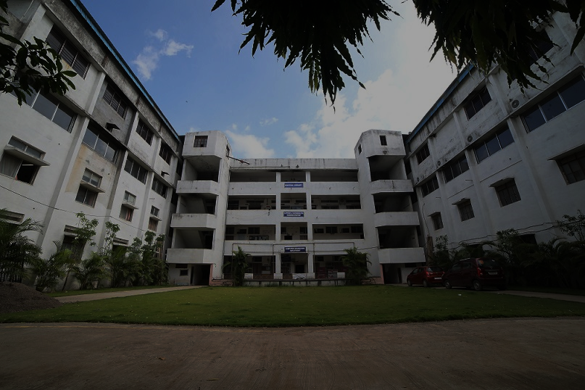

Godavari Foundation's
Godavari College of Engineering, Jalgaon
Topic
COLLEGE INVENTORY MANAGEMENT SYSTEM
Guide: Prof. Dipak Nemade
Presented :
Mr. Sumit Badgujar.
Mr. Himanshu Patil.
Miss. Sakshi Wankhede.
Miss. Rucha Suryawanshi.

Slide 2
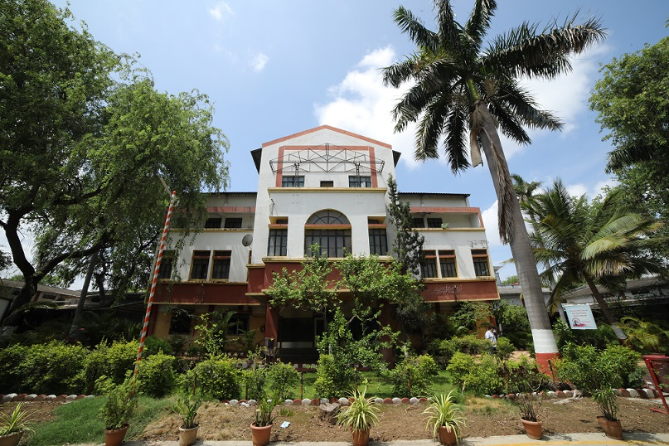
INTRODUCTION
Welcome to the presentation on the College Inventory Management System.
This system is designed to streamline and optimize the management of your college inventory.
Godavari College Of Engineering inventory management software keeps track of the College’s every materialistic asset like computer, lab equipment, furniture's and others. Be it a process of purchase management or stock transfer management, our dedicated software can handle it efficiently.

Slide 3

AIM OF THE PROJECT
Improve operations
A College inventory management system can help Colleges run more smoothly by ensuring that supplies are available when needed, and that assets are used correctly.
Reduce loss
A College inventory management system can help Colleges reduce the risk of losing inventory, and protect valuable assets like laptops and tablets.
Providing real-time data
A College inventory management system can provide real-time data that helps administrators make informed decisions.

Slide 4
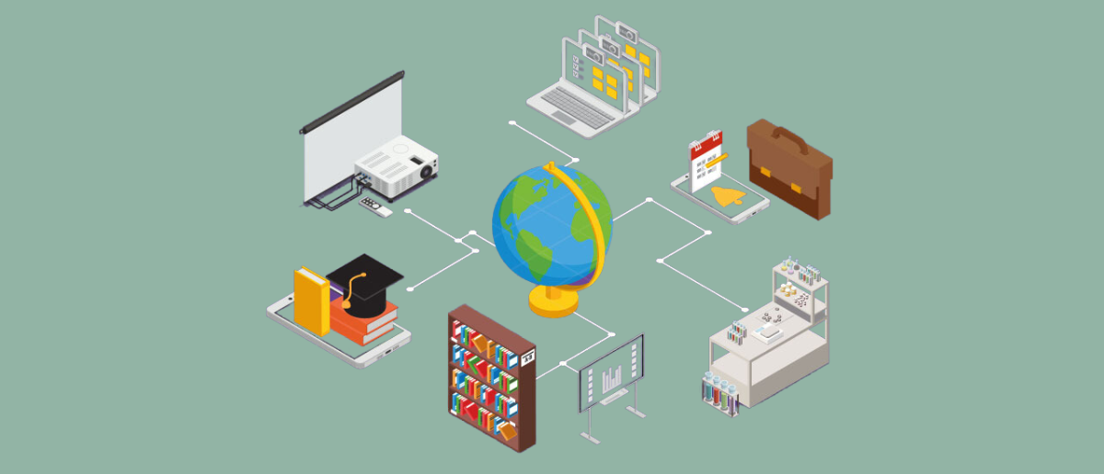
FEATURES OF THE SYSTEM
Order Processing
Efficiently handle customer orders and manage order fulfillment, ensuring timely delivery and accurate inventory updates.
User Access Control
Securely manage user access levels and permissions to maintain data integrity and prevent unauthorized modifications.
Inventory Reports
Generate insightful reports on inventory levels, sales trends, and stock status to make informed decisions regarding purchasing and production.

Slide 5
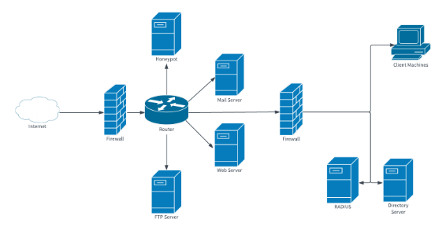
System Architecture and
Components
Database
Stores all inventory data, including item details, purchase history, and sales records.
Application Server
Processes user requests, interacts with the database, and renders web pages.
User Interface
Provides an intuitive and user-friendly interface for accessing and managing the system.

Slide 6

Data Management and Security
Data Backup
Regular data backups are essential to prevent data loss and ensure system resilience.
Data Encryption
Sensitive data, such as customer information and financial records, is encrypted to prevent unauthorized access.
Access Control
User access levels are carefully managed to ensure only authorized personnel can access specific data.

Slide 7

Implementation and Deployment
1
Requirements Gathering
Thorough understanding of user needs and system requirements.
2
System Design
Thorough understanding of user needs and system requirements.
3
Development and Testing
Coding, unit testing, and integration testing to ensure system functionality and quality.
4
Deployment and Training
System deployment in a production environment and user training on system operation.

Slide 8
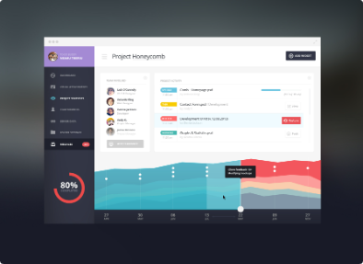
User Interface And Accessibility
Intuitive design
Easy to use . All buttons and menus or all others functionality are simple, so users can move around without confusion.
Mobile Compatibility
The system is designed to be accessible on various devices, including smartphones and tablets, for convenient access.

Slide 9
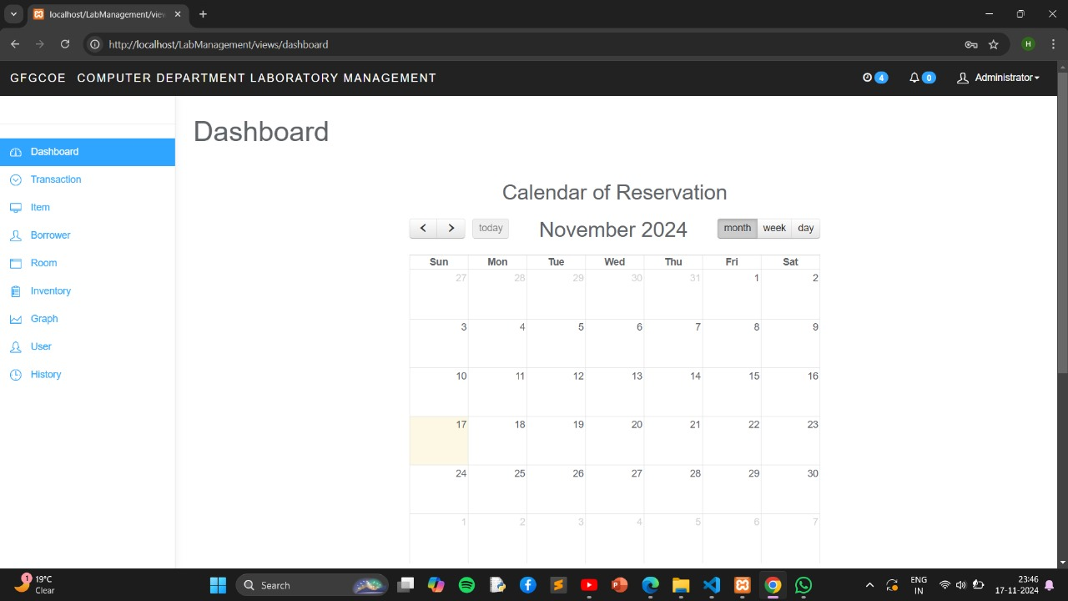
ScreenShots

Slide 10
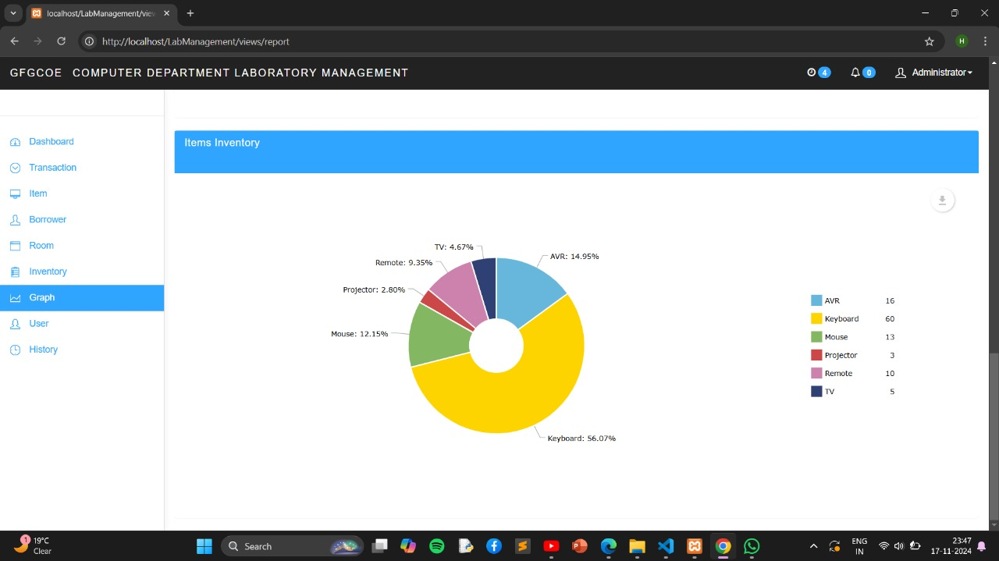

Slide 11
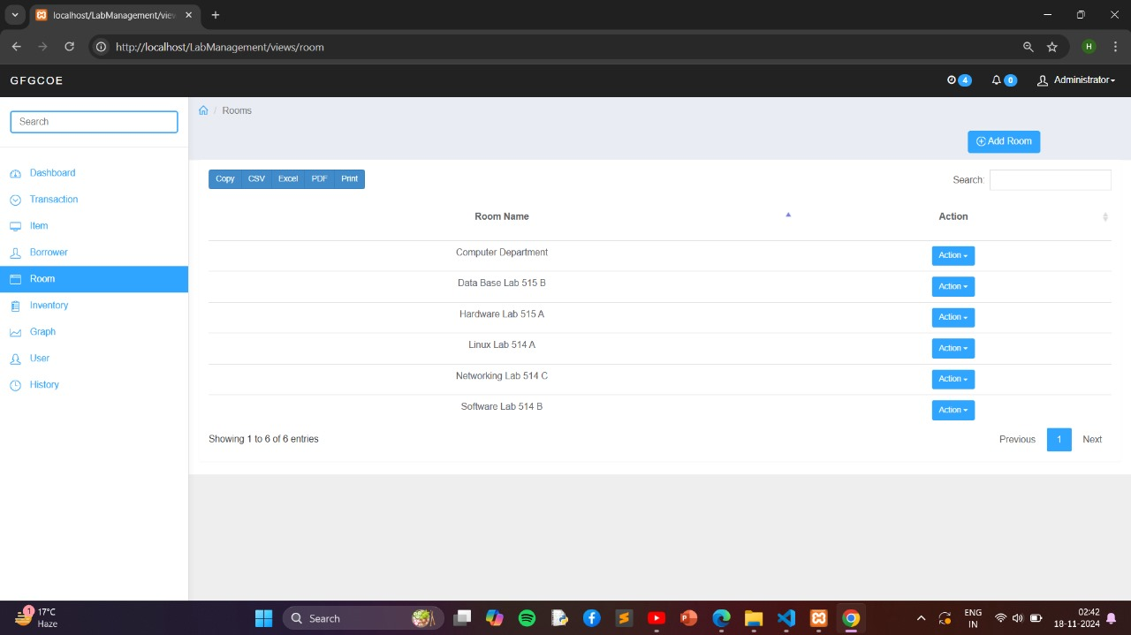

Slide 12
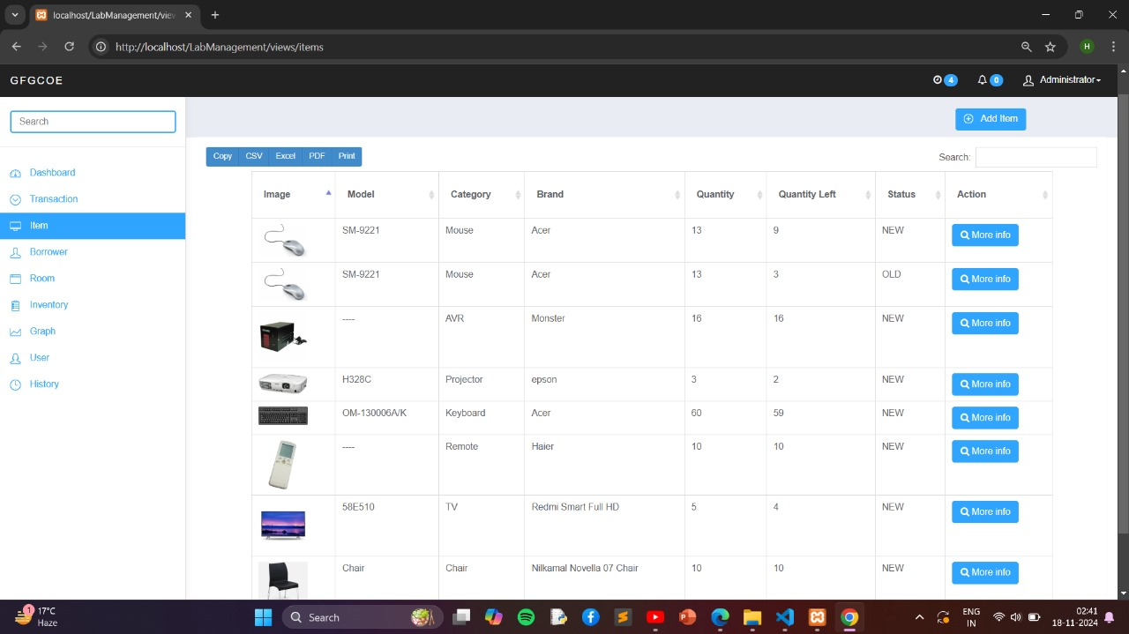

Slide 13
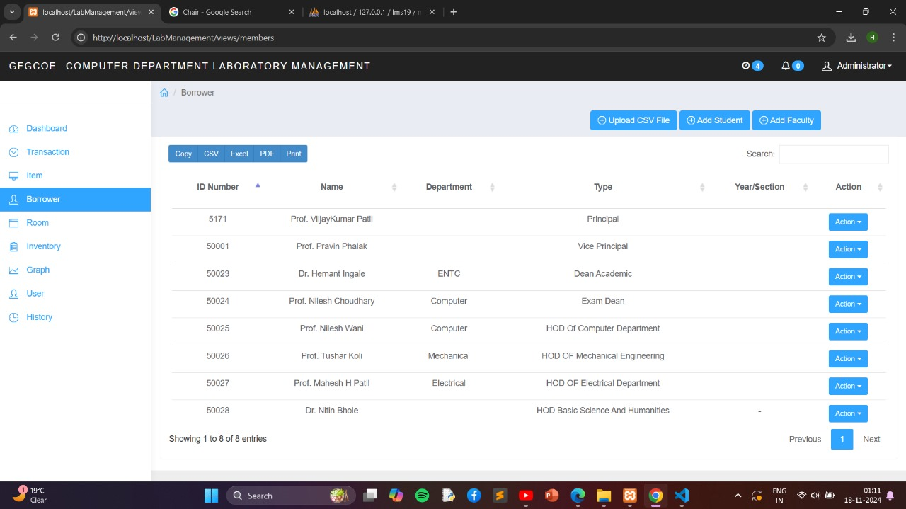

Slide 14
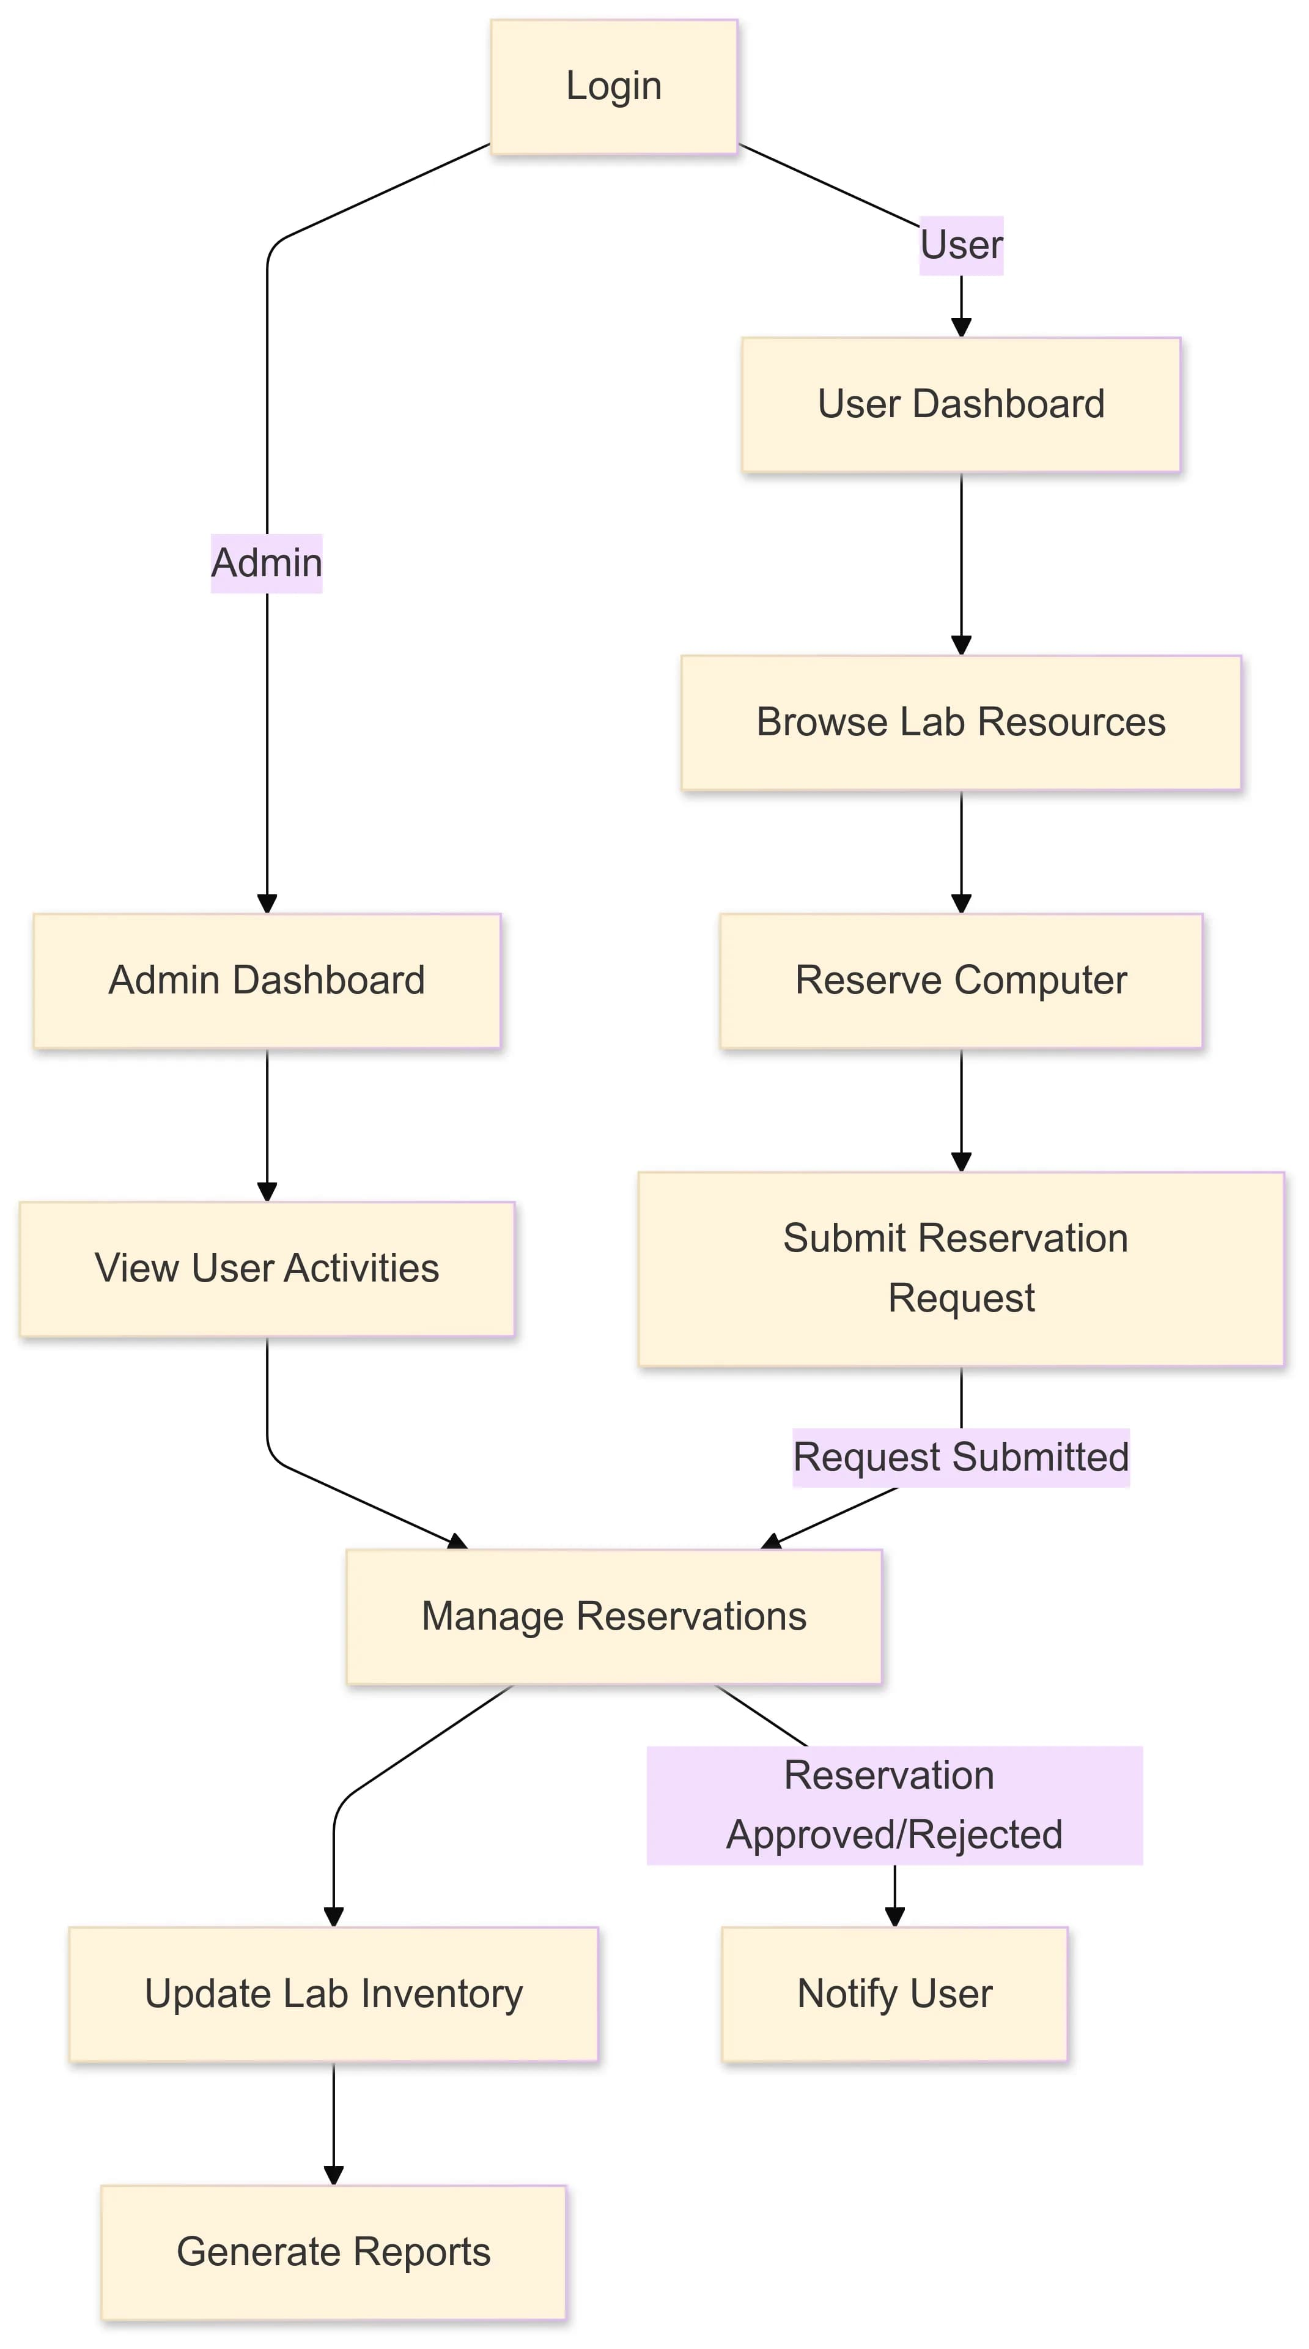

Slide 15
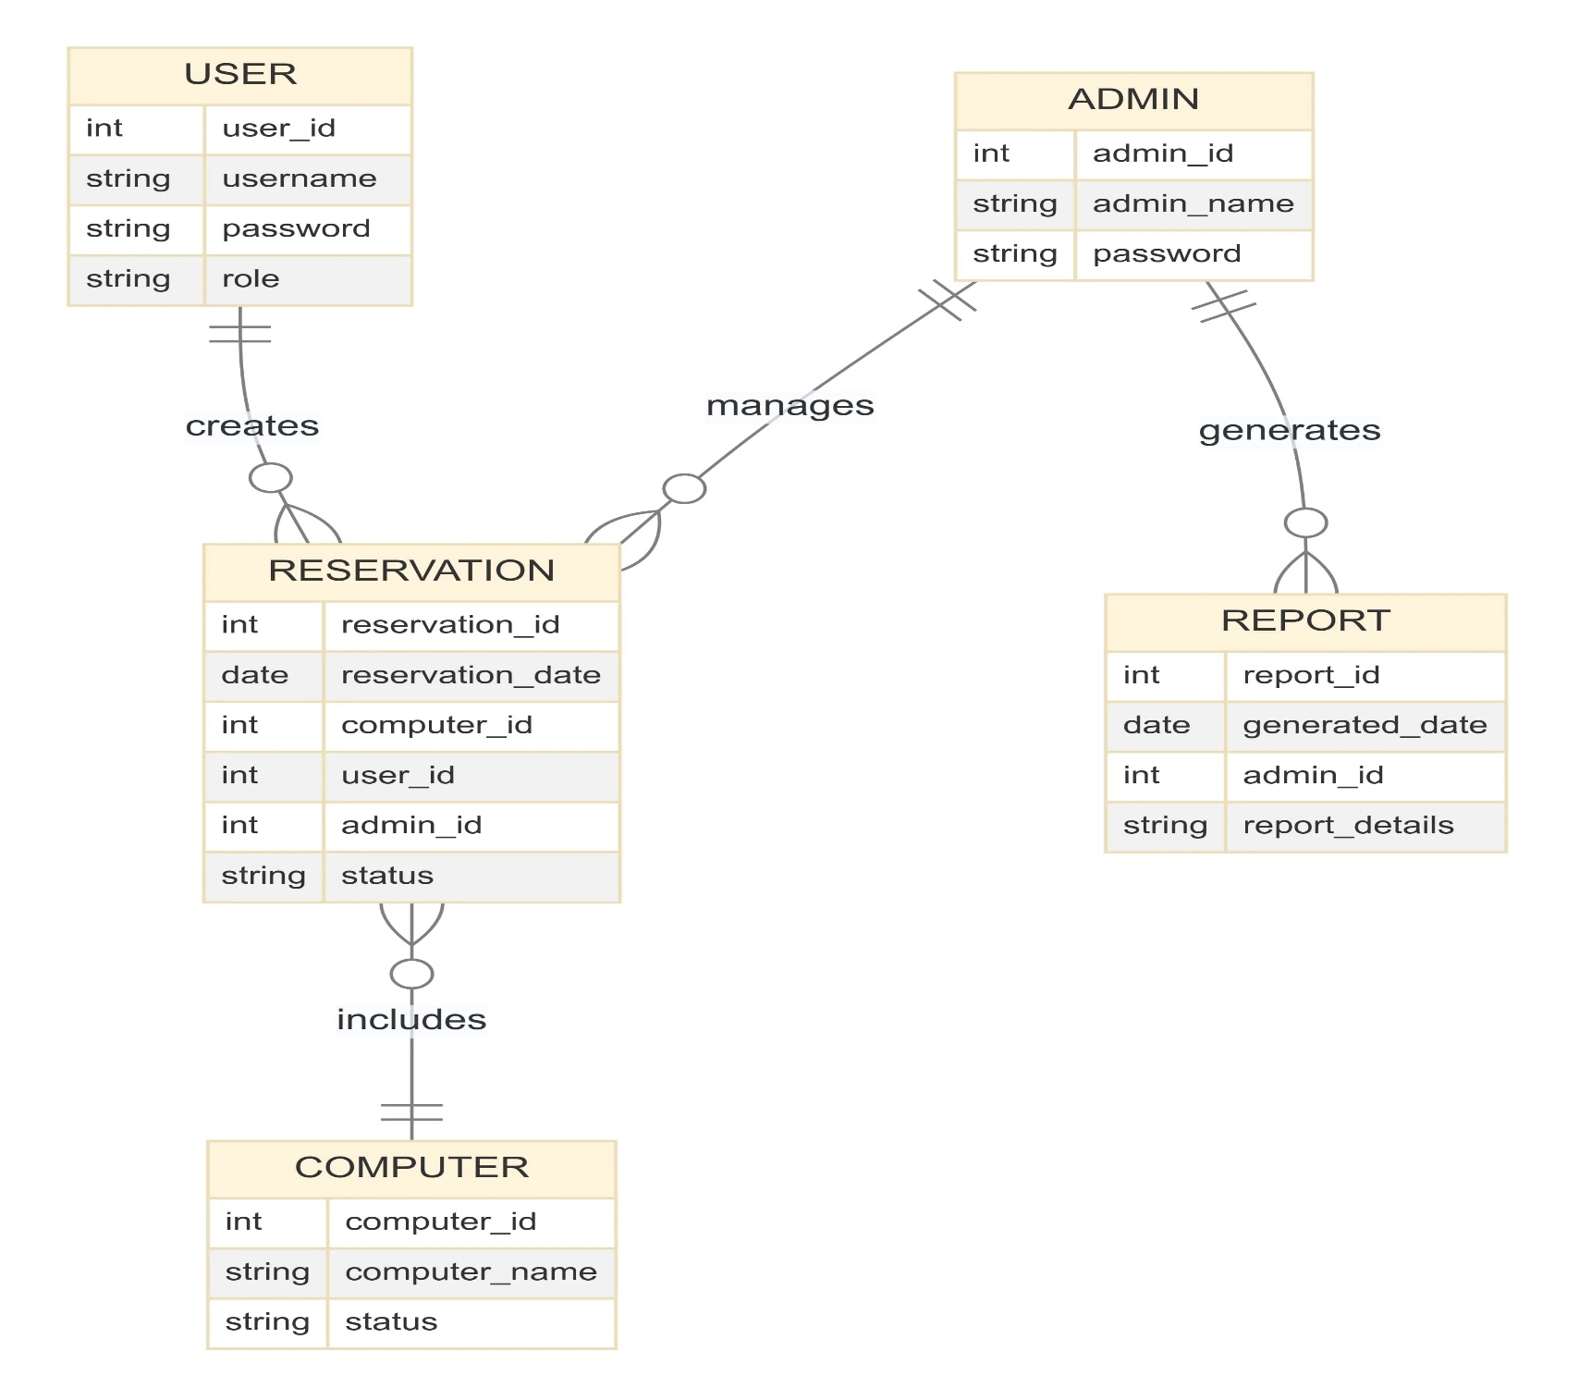

Slide 16
Future Scope
1. Real-Time Notification System
The current system notifies users through the dashboard. Adding real-time SMS or email notifications for
reservation status, approvals, or inventory updates would make the system more interactive and userfriendly.
2. Mobile Application Development
A mobile version of the system using frameworks like React Native or Flutter can provide greater
accessibility. Students and staff can manage reservations and view reports on the go, making the system
more convenient and modern.

Slide 17

Conclusion
Overall, an assets and inventory management software offers a number of benefits for College administrators. It can save time, improve decision-making, and provide valuable insights into the status of the college’s inventory. In addition, it can improve the efficiency of college administrators by allowing them to manage all of their college inventories from a single location.

Slide 18
References
Department of Computer Engineering – GFGCOE https://www.gfgcoe.in/computer-engineering-ug-2/
2. W3Schools
Website: https://www.w3schools.com/
3. . YouTube – Technical Channels (e.g., CodeWithHarry, Clever Programmer)

